Slide 1
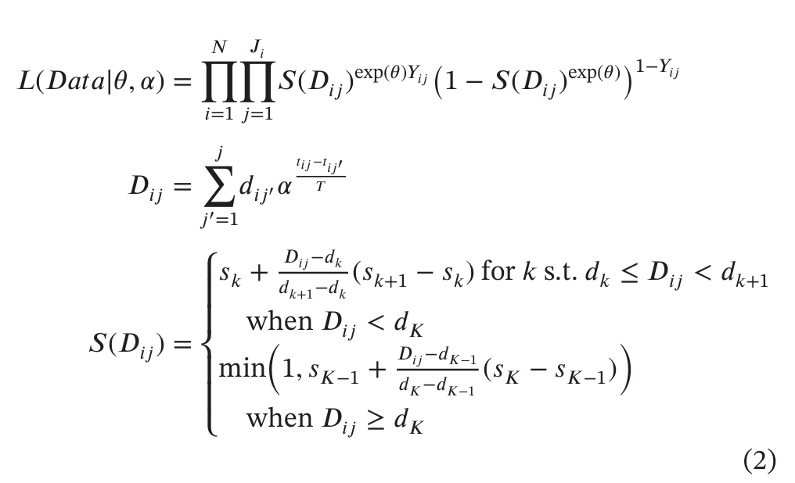

Alpha CRM and IPCRM

Slide 2
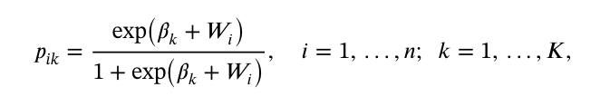
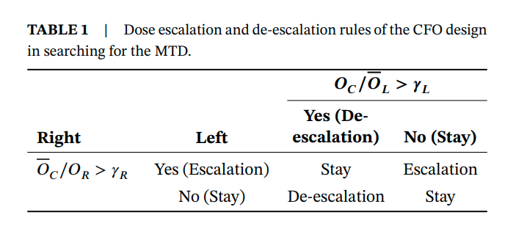
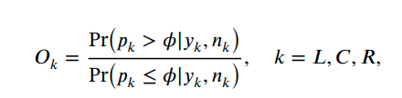
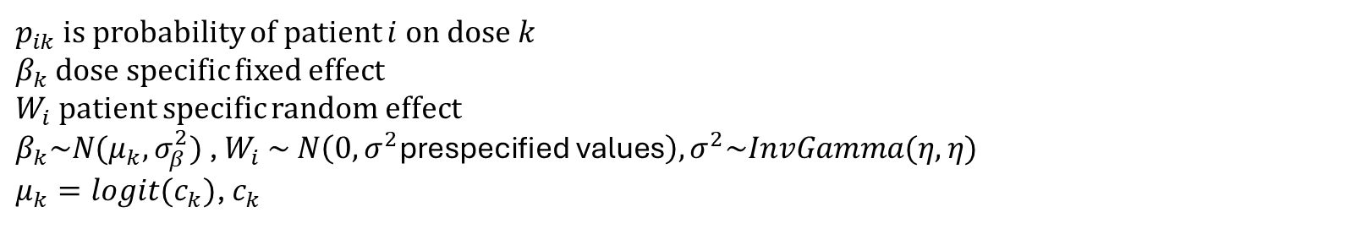
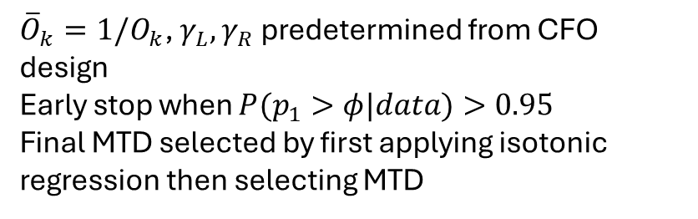
CFO-PRIDE
$p_{ik}$ is probability of patient $i$on dose $k$
$β_{k}$ dose specific fixed effect
$W_{i}$ patient specific random effect
$β_{k}\sim N(μ_{k},σ_{β}^{2})$ , $W_{i} \sim N\left(0,σ^{2}\text{prespecified} \text{values}\right),σ^{2}\sim InvGamma(η,η)$
$μ_{k}=logit(c_{k})$, $c_{k}$
${\overline{O}}_{k}=1/O_{k}$, $γ_{L},γ_{R}$ predetermined from CFO design
Early stop when $P(p_{1}>φ|data)>0.95$
Final MTD selected by first applying isotonic regression then selecting MTD

Slide 3
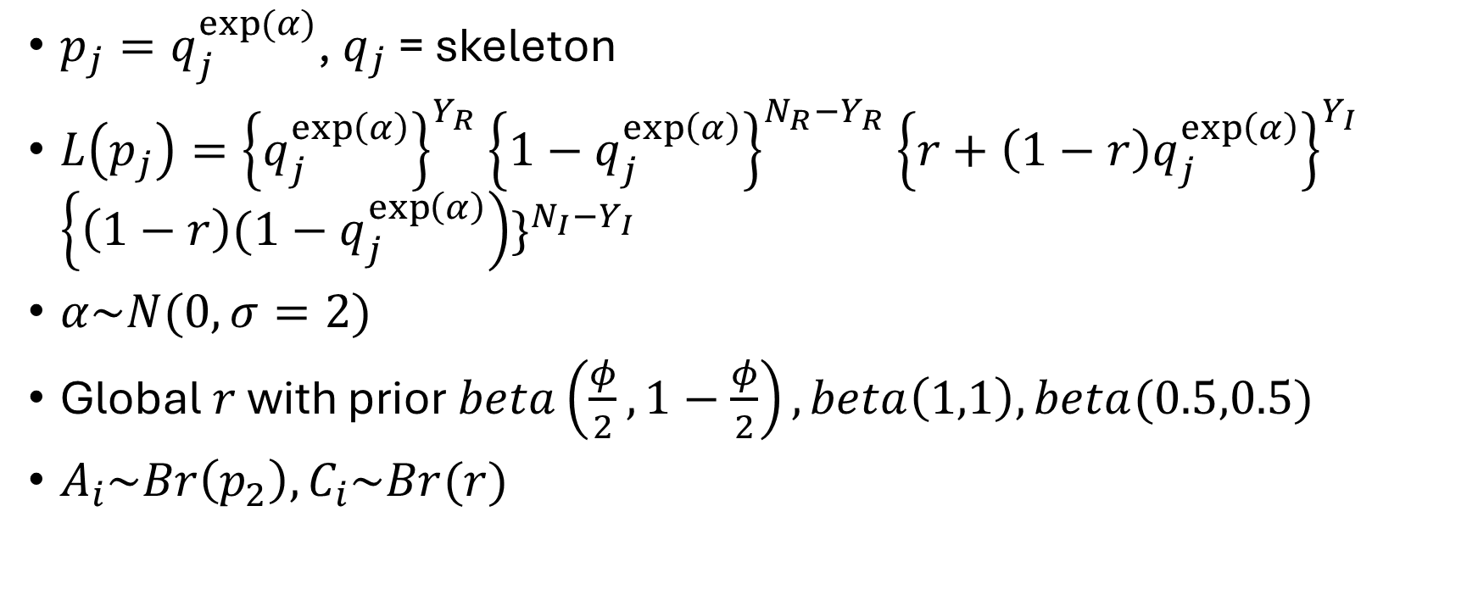
Proposed CRM
$p_{j}=q_{j}^{exp⁡(α)}$, $q_{j}$ = skeleton
$L\left(p_{j}\right)={\left\{q_{j}^{\exp\left(α\right)}\right\}}^{Y_{R}}{\left\{1−q_{j}^{\exp\left(α\right)}\right\}}^{N_{R}−Y_{R}}{\left\{r+\left(1−r\right)q_{j}^{\exp\left(α\right)}\right\}}^{Y_{I}}$ ${\left\{\left(1−r\right){(1−q}_{j}^{\exp\left(α\right)}\right)\}}^{N_{I}−Y_{I}}$
$α\sim N(0,σ=2)$
Global $r$ with prior $beta\left(\frac{φ}{2}, 1−\frac{φ}{2}\right),beta\left(1,1\right), beta(0.5,0.5)$
$A_{i}\sim Br\left(p_{2}\right), C_{i}\sim Br(r)$

Slide 4
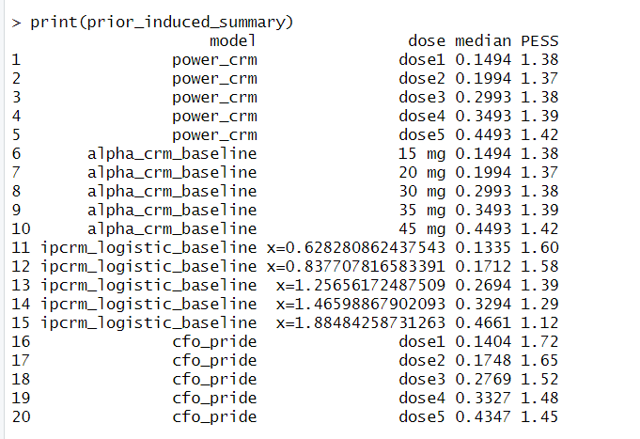
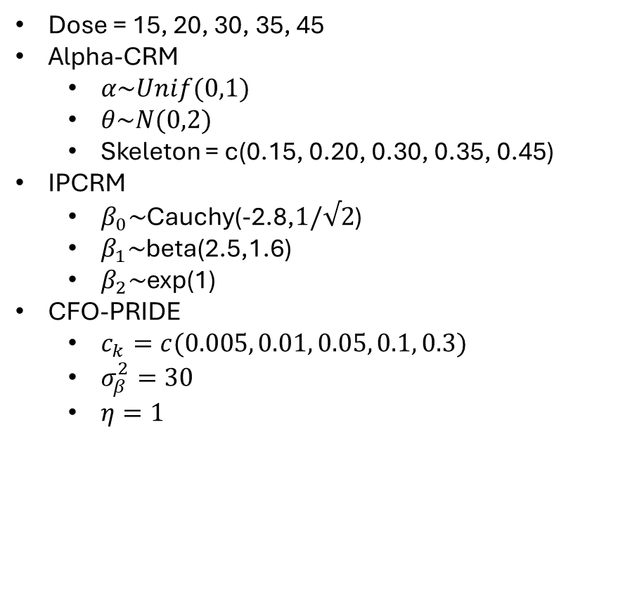
Prior Settings 5 dose
Dose = 15, 20, 30, 35, 45
Alpha-CRM
$α\sim Unif(0,1)$
$θ\sim N(0,2)$
Skeleton = c(0.15, 0.20, 0.30, 0.35, 0.45)
IPCRM
$β_{0}\sim$Cauchy(-2.8,$1/√2$)
$β_{1}\sim$beta(2.5,1.6)
$β_{2}\sim$exp(1)
CFO-PRIDE
$c_{k}=c(0.005, 0.01, 0.05, 0.1, 0.3)$
$σ_{β}^{2}=30$
$η=1$

Slide 5
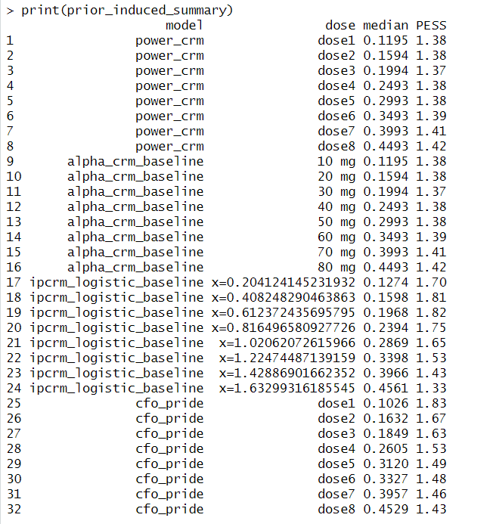

Prior settings 8 dose
Dose = 10, 20, 30, 40, 50, 60, 70, 80
Alpha-CRM
$α\sim Unif(0,1)$
$θ\sim N(0,2)$
Skeleton = c(0.12,0.16,0.20,0.25,0.30,0.35,0.40,0.45)
IPCRM
$β_{0}\sim$Cauchy(-2.2,$1/√2$)
$β_{1}\sim$beta(2.2,1.6)
$β_{2}\sim$exp(1)
CFO-PRIDE
$c_{k}=c\left(0.002, 0.008, 0.012, 0.04, 0.08, 0.1, 0.2, 0.35\right)$
$σ_{β}^{2}=30$
$η=1$

Slide 6

Scenario generation
N = 30, 45 for 5 doses
N = 30, 45, 60 for 8 doses
For IPDE patient, $p_{k,ipde}=p_{k}+{αp}_{k−1}$
$α=0, 0.3, 0.6, 0.9, 1.2, 1.5$

Slide 7
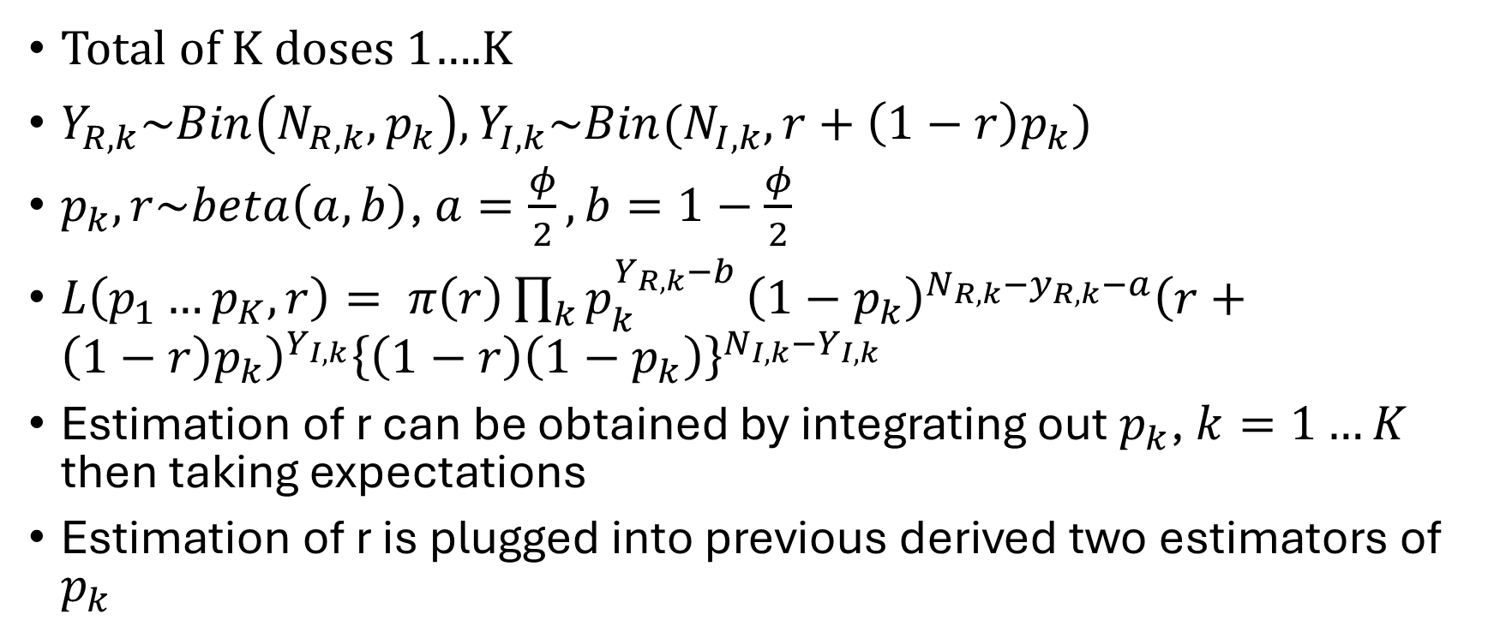
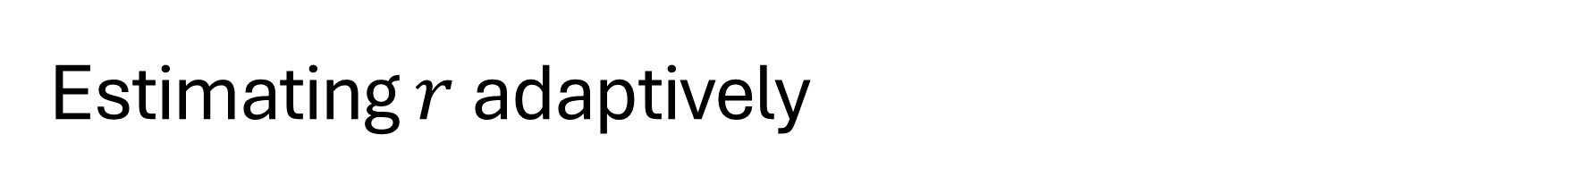
Estimating $r$ adaptively
Total of K doses 1….K
$Y_{R,k}\sim Bin\left(N_{R,k},p_{k}\right), Y_{I,k}\sim Bin(N_{I,k},r+\left(1−r\right)p_{k})$
$p_{k},r\sim beta\left(a,b\right)$, $a=\frac{φ}{2}, b=1−\frac{φ}{2}$
$L\left(p_{1}…p_{K},r\right)= π\left(r\right)\prod_{k}{p_{k}^{Y_{R,k}−b}}{\left(1−p_{k}\right)}^{N_{R,k}−y_{R,k}−a}{\left(r+\left(1−r\right)p_{k}\right)}^{Y_{I,k}}{\left\{\left(1−r\right)\left(1−p_{k}\right)\right\}}^{N_{I,k}−Y_{I,k}}$
Estimation of r can be obtained by integrating out $p_{k}$, $k=1…K$ then taking expectations
Estimation of r is plugged into previous derived two estimators of $p_{k}$

Slide 8
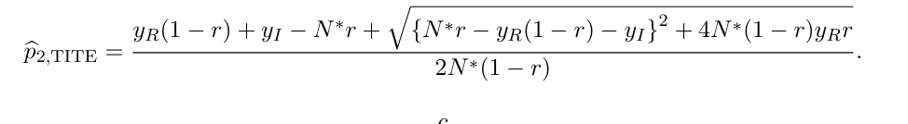

Approx1
$N^{∗}=N_{R,c}+N_{I,C}$
$N_{I,c}, N_{R,C}$ are number of evaluated IPDE, regular patient without DLT
$y_{R},y_{I}$ are observed DLT of regular and IPDE patient

Slide 9
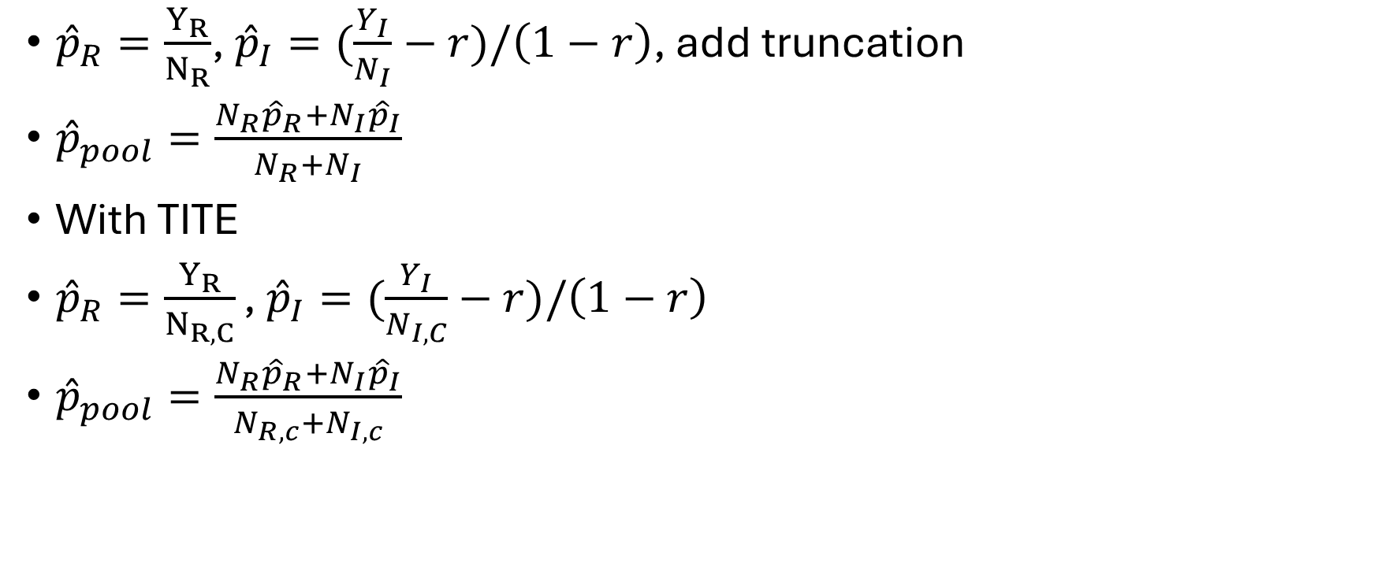
Pooled Estimator - Approx 2
${\hat{p}}_{R}=\frac{Y_{R}}{N_{R}}$, ${\hat{p}}_{I}=(\frac{Y_{I}}{N_{I}}−r)/\left(1−r\right)$, add truncation
${\hat{p}}_{pool}=\frac{N_{R}{\hat{p}}_{R}+N_{I}{\hat{p}}_{I}}{N_{R}+N_{I}}$
With TITE
${\hat{p}}_{R}=\frac{Y_{R}}{N_{R,C}}\text{, }{\hat{p}}_{I}=(\frac{Y_{I}}{N_{I,C}}−r)/\left(1−r\right)$
${\hat{p}}_{pool}=\frac{N_{R}{\hat{p}}_{R}+N_{I}{\hat{p}}_{I}}{N_{R,c}+N_{I,c}}$

Slide 10
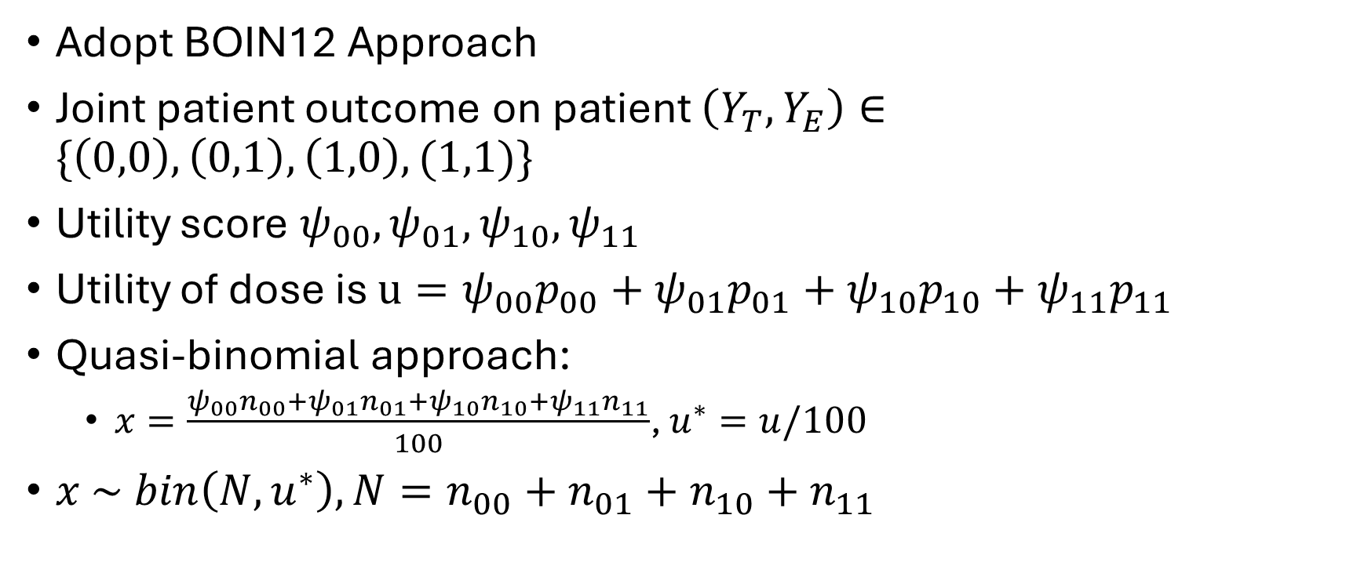
Incorporate carryover into TITE-BOIN12 Utility
Adopt BOIN12 Approach
Joint patient outcome on patient $\left(Y_{T},Y_{E}\right)∈\{\left(0,0\right),\left(0,1\right),\left(1,0\right),(1,1)\}$
Utility score $ψ_{00},ψ_{01},ψ_{10},ψ_{11}$
Utility of dose is $u=ψ_{00}p_{00}+ψ_{01}p_{01}+ψ_{10}p_{10}+ψ_{11}p_{11}$
Quasi-binomial approach:
$x=\frac{ψ_{00}n_{00}+ψ_{01}n_{01}+ψ_{10}n_{10}+ψ_{11}n_{11}}{100}$, $u^{∗}=u/100$
$x \sim bin\left(N,u^{∗}\right), N=n_{00}+n_{01}+n_{10}+n_{11}$

Slide 11
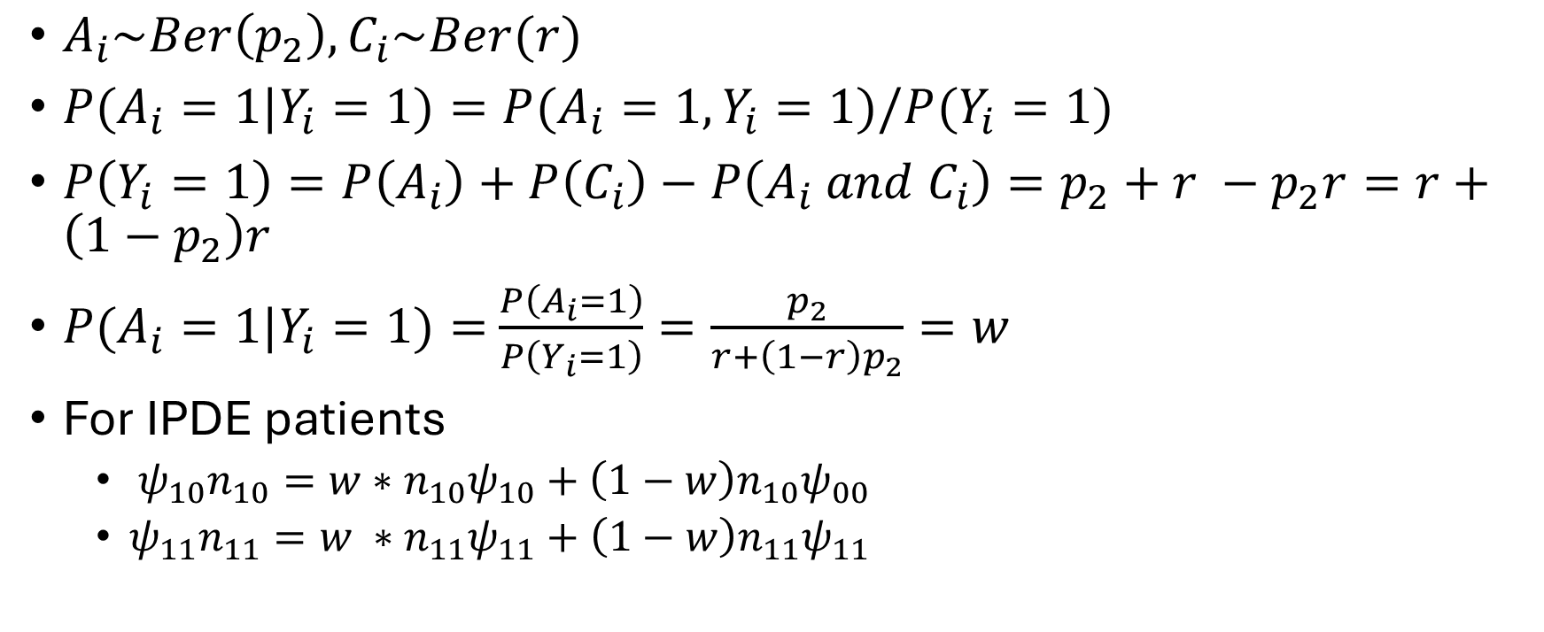
Incorporating carryover parameter r
$A_{i}\sim Ber\left(p_{2}\right), C_{i}\sim Ber(r)$
$P(A_{i}=1|Y_{i}=1)=P(A_{i}=1, Y_{i}=1)/P(Y_{i}=1)$
$P\left(Y_{i}=1\right)=P\left(A_{i}\right)+P\left(C_{i}\right)−P\left(A_{i} and C_{i}\right)=p_{2}+r −p_{2}r=r+\left(1−p_{2}\right)r$
$P(A_{i}=1|Y_{i}=1)=$ $\frac{P\left(A_{i}=1\right)}{P\left(Y_{i}=1\right)}=\frac{p_{2}}{r+\left(1−r\right)p_{2}}=w$
For IPDE patients
$ψ_{10}n_{10}=w∗n_{10}ψ_{10}+\left(1−w\right)n_{10}ψ_{00}$
$ψ_{11}n_{11}=w ∗n_{11}ψ_{11}+\left(1−w\right)n_{11}ψ_{11}$

Slide 12

$x_{adj}=\frac{ψ_{00}n_{00}+ψ_{01}n_{01}+ψ_{10}n_{10,R}+ψ_{11}n_{11,R}+w∗n_{10,I}ψ_{10}+\left(1−w\right)n_{10,I}ψ_{00}}{100}$

Slide 13
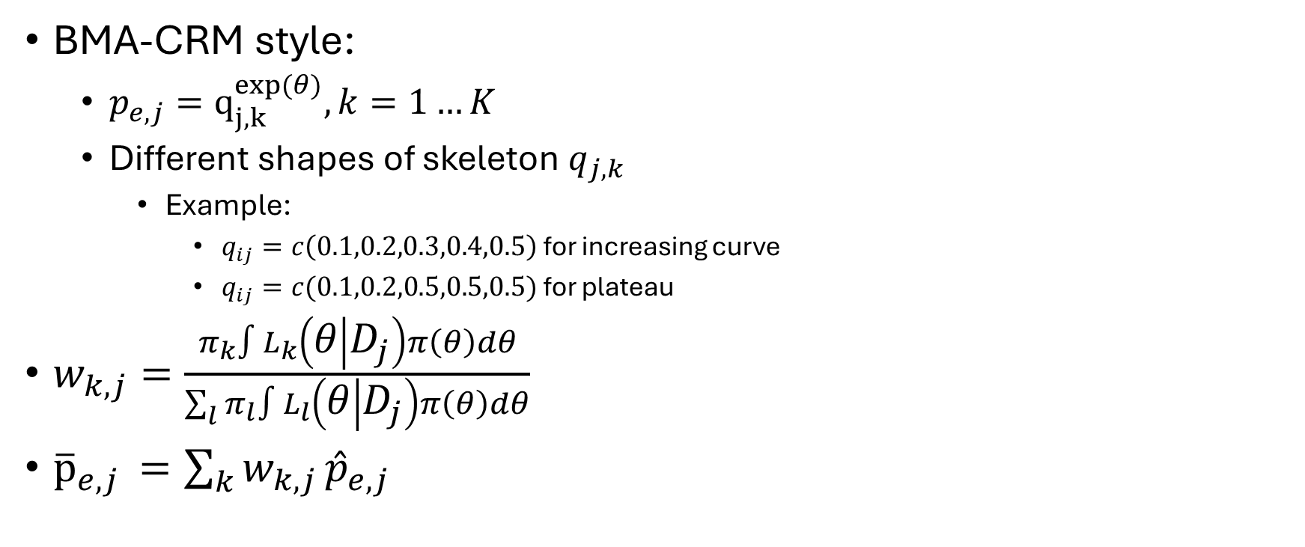
Possible Efficacy Model
BMA-CRM style:
$p_{e,j}=q_{j,k}^{exp⁡(θ)}, k=1…K$
Different shapes of skeleton $q_{j,k}$
Example:
$q_{ij}=c\left(0.1,0.2,0.3,0.4,0.5\right)$ for increasing curve
$q_{ij}=c(0.1,0.2,0.5,0.5,0.5)$ for plateau
$w_{k,j}=\frac{π_{k}∫L_{k}\left(θ | D_{j}\right)π\left(θ\right)dθ}{\sum_{l}{π_{l}∫L_{l}\left(θ | D_{j}\right)π\left(θ\right)dθ}}$
${\overline{p}}_{e,j }=\sum_{k}{w_{k,j}}{\hat{p}}_{e,j}$

Slide 14
Measure to quantify variability in MTD selection
Suspension in trial design + 3 evaluated patient
Remove rule 5 no skipping
For original AIDE, consider patient arrival time, prioritize new patient
Toxicity – power model, efficacy – beta-binomial, two stage
(1,0),(0,1),(0,0),(1,1) multinomial, constraint on p1 + p3 marginal of toxicity
YT,YE | Z = 0 = (p1,p2,p3,p4), correlation parameter rho
YT,YE | Z = 1 = (p1*, p2*, p3*, p4*), same correlation parameter rho

